Slide 1
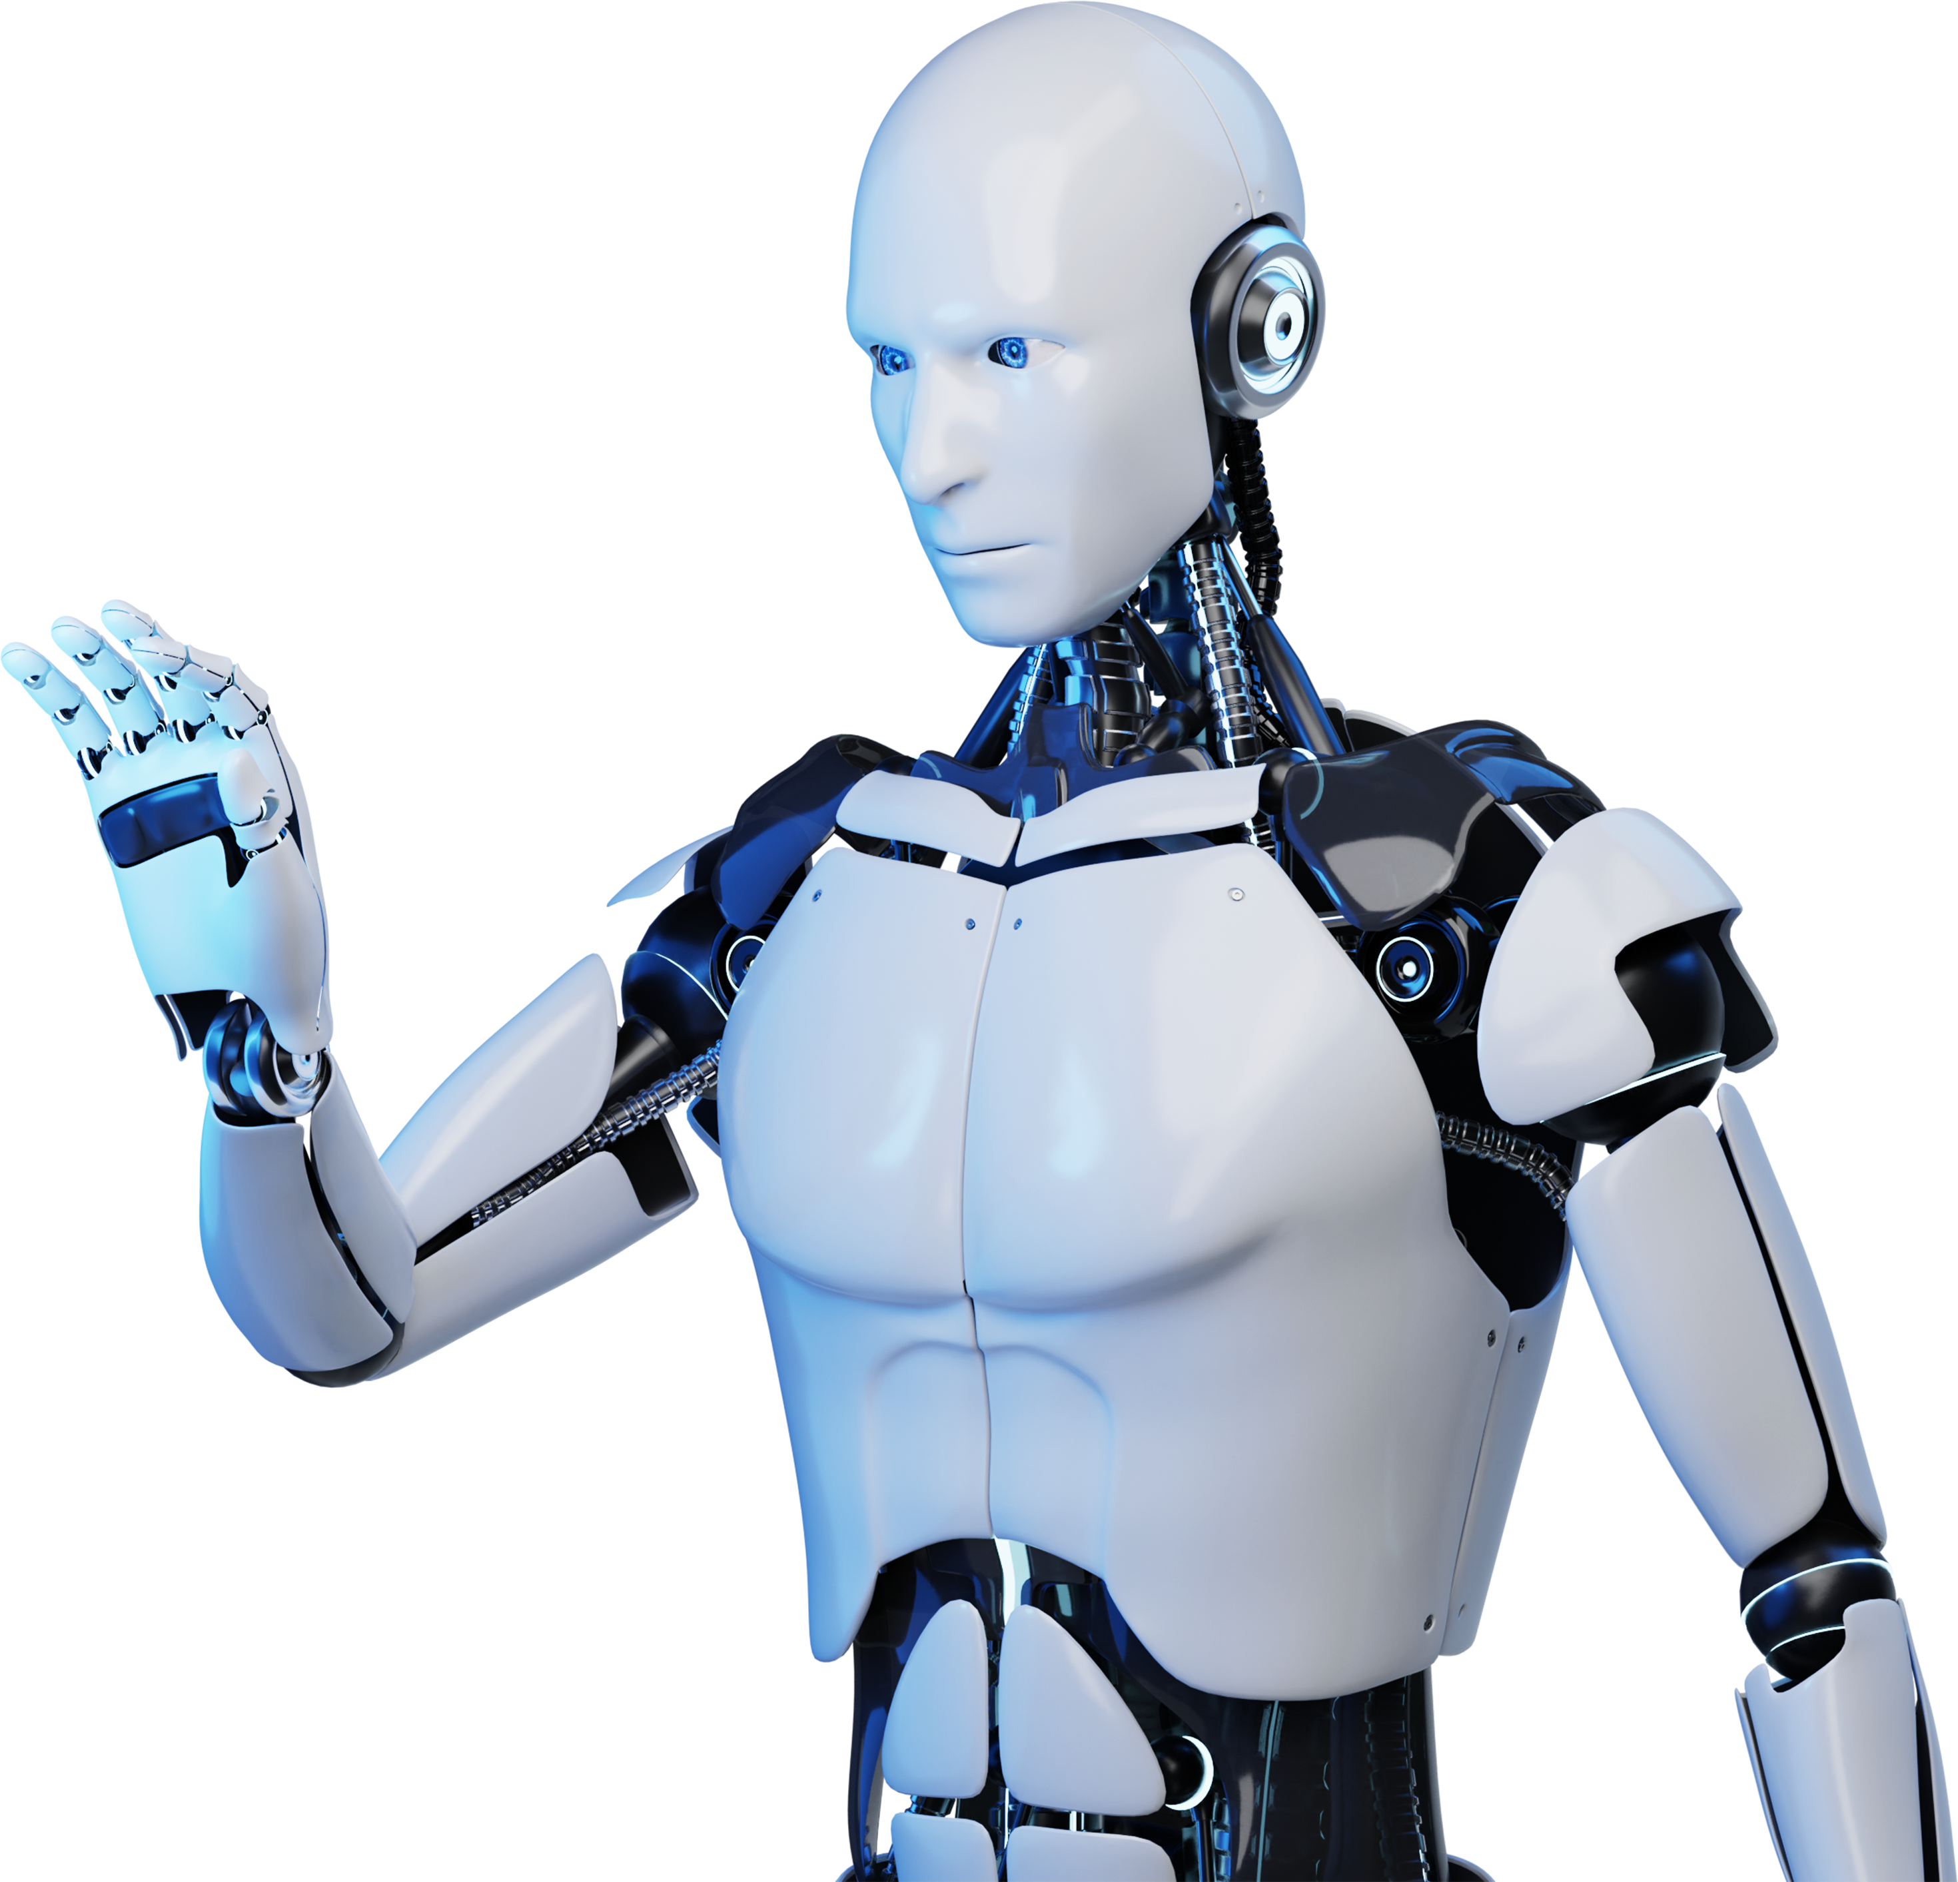
AGENTIC RAG CHATBOT
Presented by Satwika.

Slide 2

Table Of Contents
01. Introduction of AI Chatbots
02. Agent-Based Architecture with MCP
03. System Flow with Message Passing
04. Tech Stack
05. UI Screenshots of the App
06. Challenges Faced + Future Scope

Slide 3
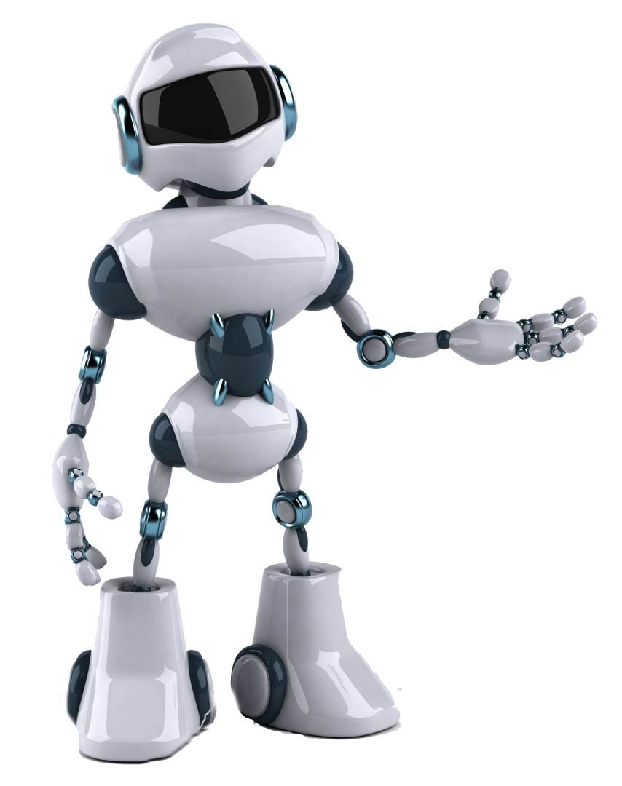
Introduction
AI chatbots are intelligent programs designed to simulate human-like conversations.
They understand user queries, process context, and respond in natural language.
With advancements like RAG (Retrieval-Augmented Generation), chatbots can now provide more accurate, document-aware responses.

Slide 4
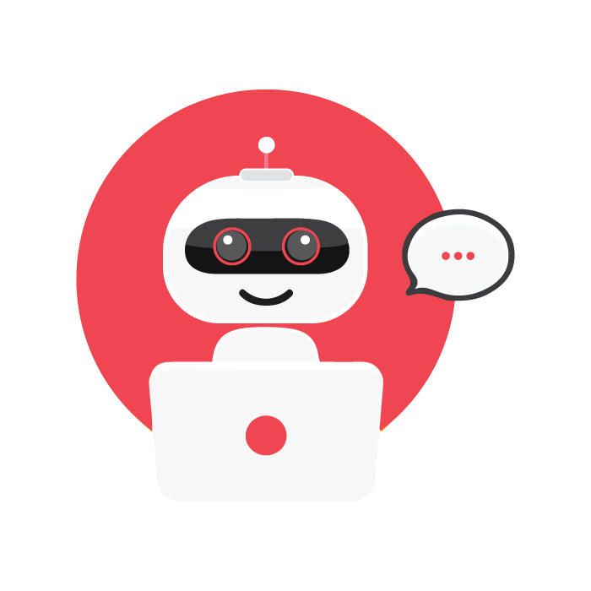
Agent-Based Architecture with MCP
Uses a modular agent-based design for clear separation of tasks.
Coordinator Agent orchestrates sub-agents to handle retrieval, response generation, and formatting.
Integrated with Model Context Protocol (MCP) to ensure context consistency across agent interactions.

Slide 5
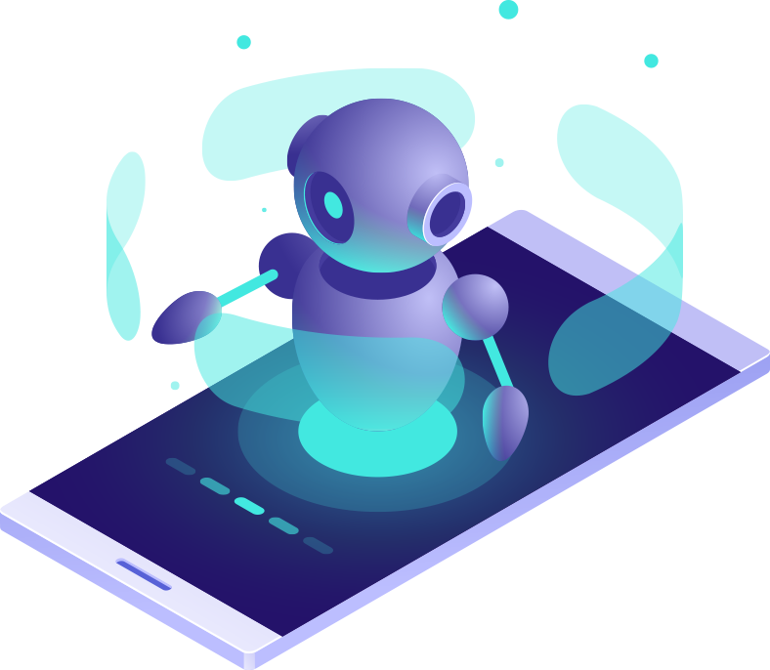
System Flow with Message Passing
How the System Works?
User uploads files (PDF, DOCX, PPTX, etc..)
Files processed into readable text chunks
User asks a query → Coordinator routes it via MCP
Relevant document parts retrieved
Final answer generated and displayed

Slide 6
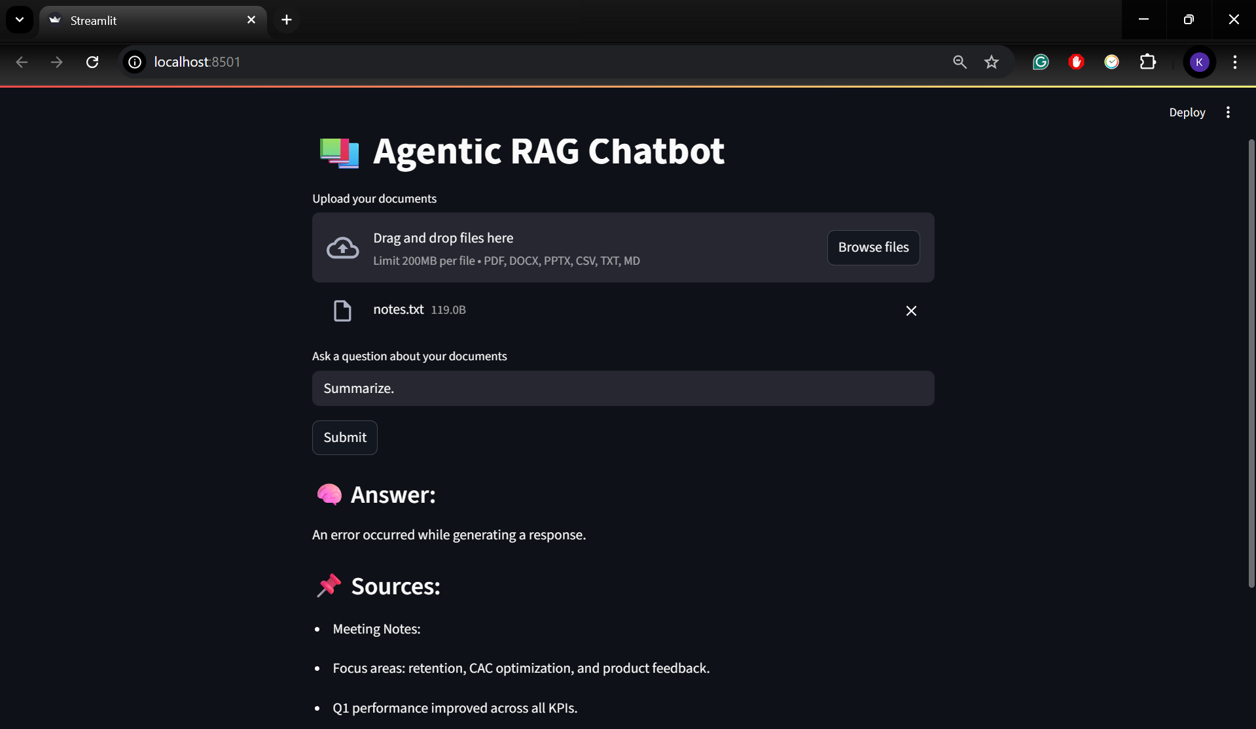

Slide 7
Tech Stack
1
Frontend: Streamlit (custom UI, real-time inputs)
2
Backend: Python, FAISS for similarity search
3
Embeddings: Sentence Transformers
4
Parsing: PyMuPDF, python-docx, python-pptx
5
Orchestration: MCP protocol and CoordinatorAgent

Slide 8
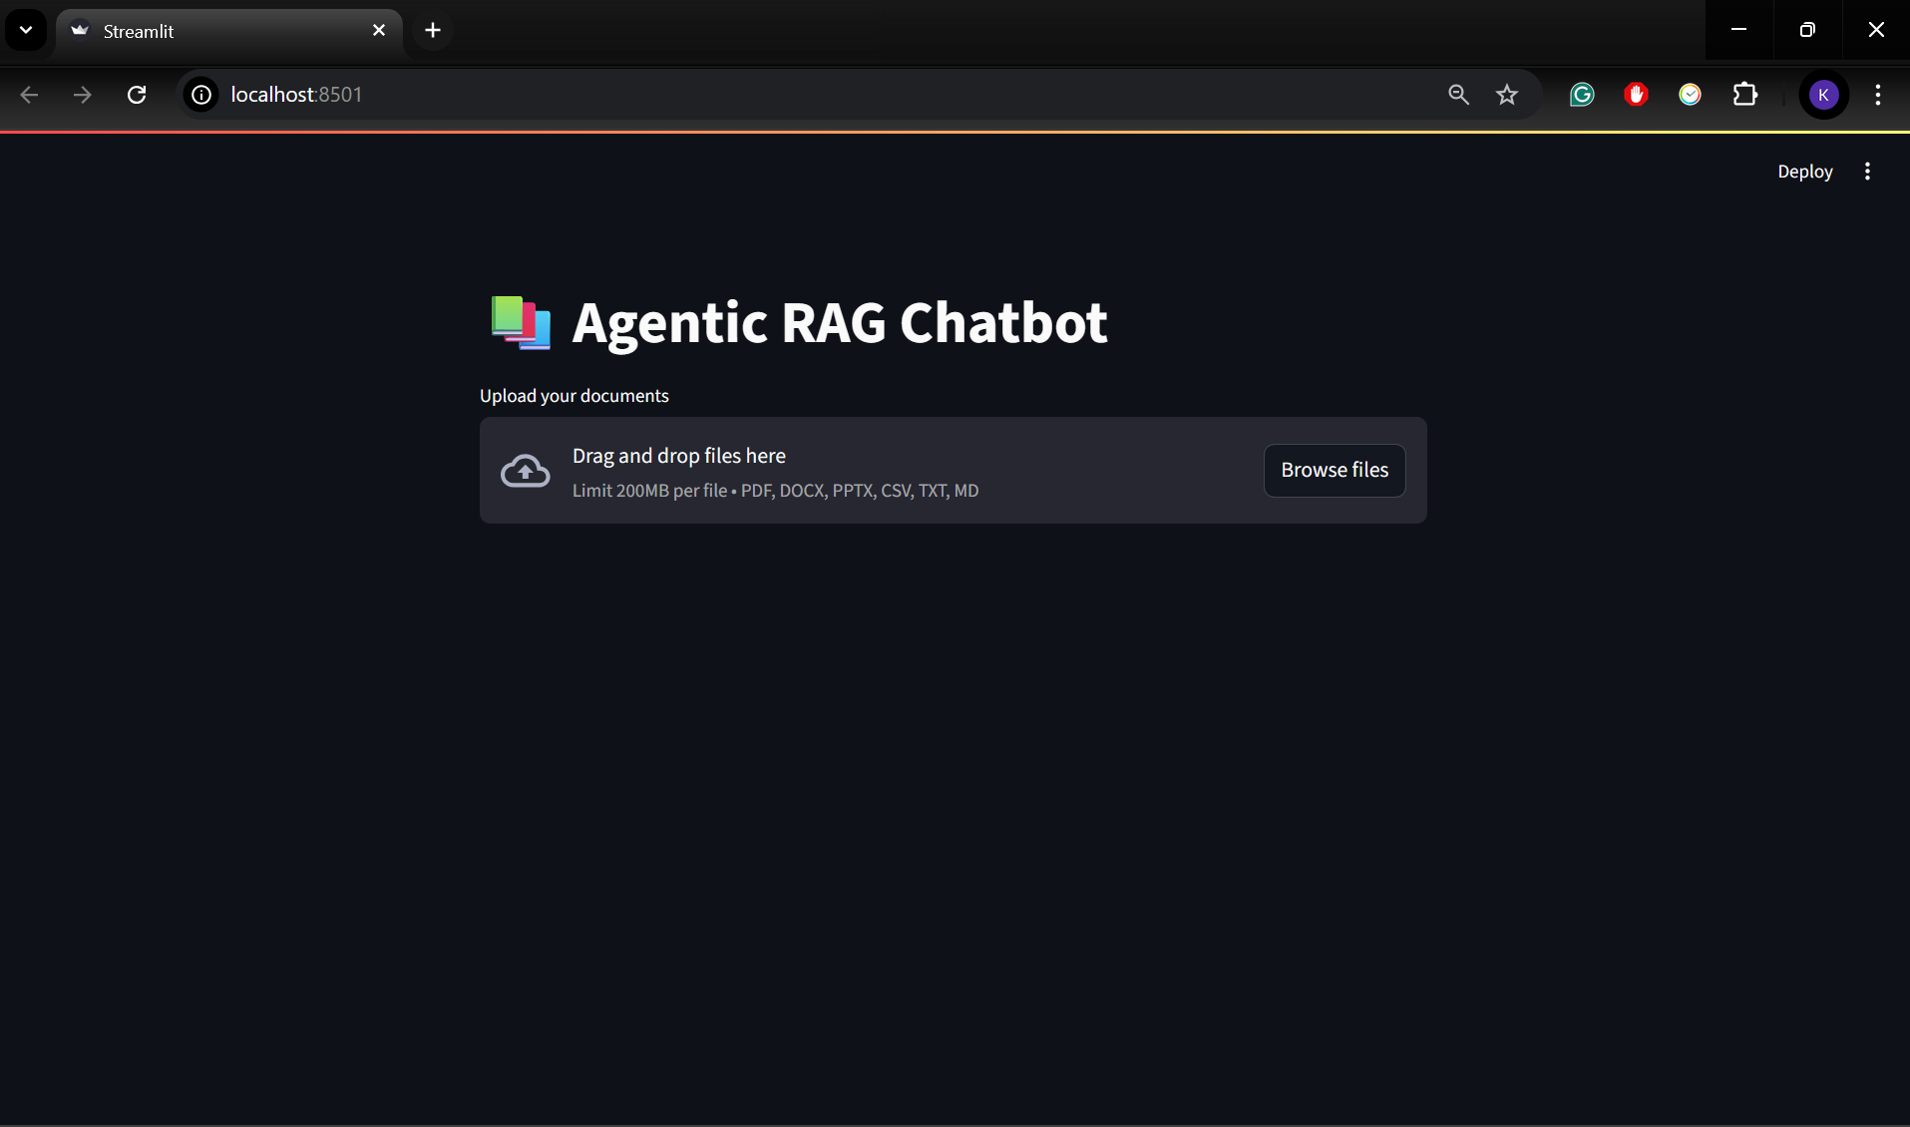
UI Screenshots of the App

Slide 9
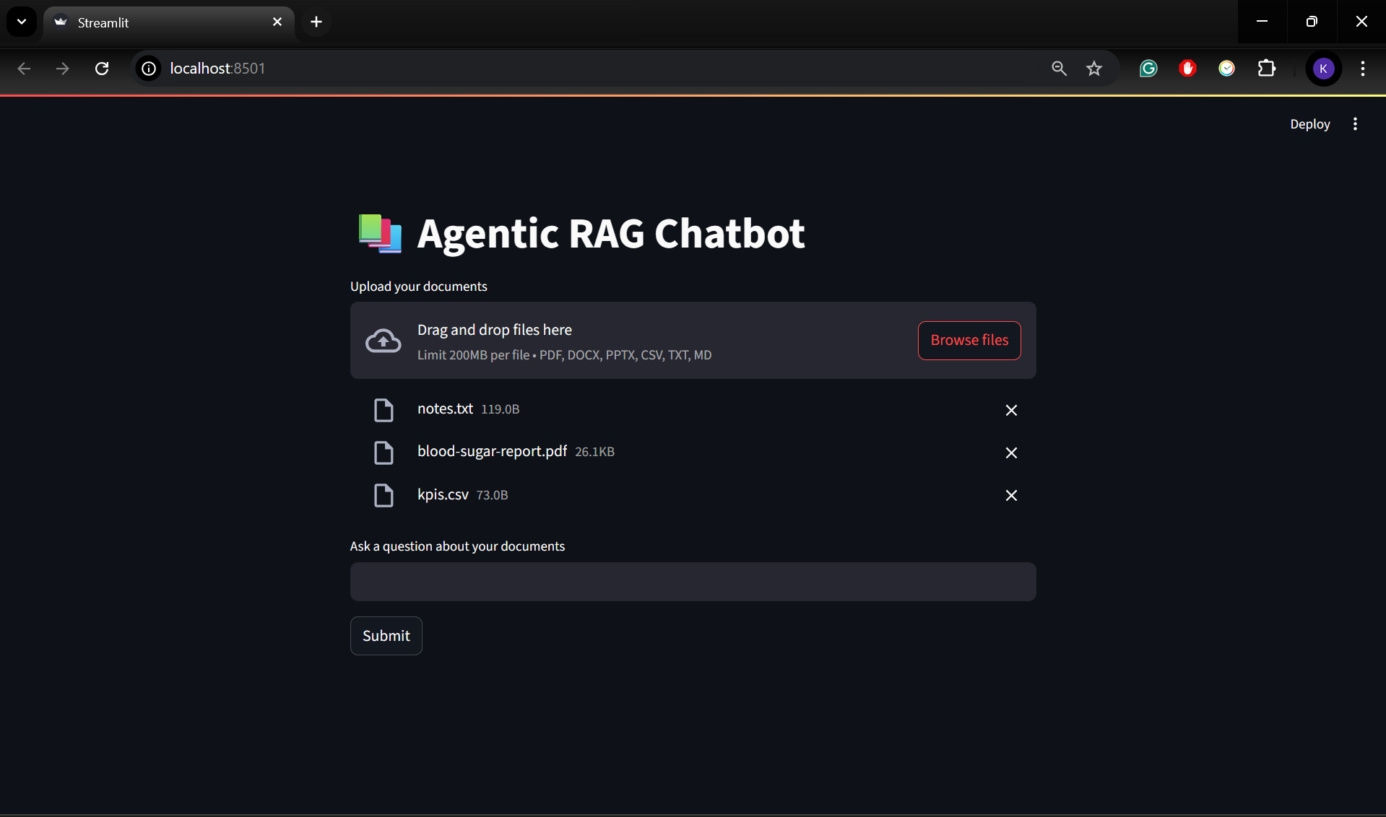
UI Screenshots of the App

Slide 10
Challenges Faced + Future Scope
Challenges:
Structuring agent communication without losing context.
Document parsing inconsistencies across formats.
Keeping UI responsive with large files.
Future Scope:
Add support for scanned image PDFs (OCR).
Improve response grounding and explainability.
Export chat history with citation references.

Slide 11

Thankyou

